Slide 1


To Our Presentation..

Slide 2







Course Teacher
AYESHA SIDDIKA LECTURER
DEPT OF CSE
COURSE CODE : CSE-236

Slide 3

Team Leader
MD MUTASADDIK LIMON
0282230005101030
DEPT OF CSE

Slide 4
1ST Member
MD AL-AMIN SHAOWN
0282230005101036
DEPT OF CSE

Slide 5

2nd Member
KANIZ FATEMA JUTHI
0282230005101054
DEPT OF CSE

Slide 6

Outline :
Introduction to Dijkstra algorithm
Pseudocode / Time Complexity
Graph
Example
Implement With C Program
Input & Output
Advantages/ Disadvantages
Conclusion

Slide 7
Dijkstra's Algorithm
Definition:
Pseudocode
With Dijkstra's Algorithm, you can find the shortest path between nodes in a graph. Particularly, you can find the shortest path from a node (called the "source node") to all other nodes in the graph, producing a shortest-path tree.
This algorithm was created and published by :
Dr . Edsger W. Dijkstra, a brilliant Dutch computer scientist
and software engineer in 1959.
Pseudocode function Dijkstra (Graph, source):
for each vertex v in Graph.Vertices:
dist[v] ← INFINITY
prev[v] ← UNDEFINED
add v to Q
dist[source] ← 0
while Q is not empty:
u ← vertex in Q with min dist[u]
remove u from Q
for each neighbor v of u still in Q:
alt ← dist[u] + Graph.Edges(u, v)
if alt < dist[v]:
dist[v] ← alt
prev[v] ← u
return dist[], prev[]
Time Complexity :
Time Complexity of Dijkstra's Algorithm is O ( V 2 )but
with min-priority queue it drops down to
O ( V + E l o g V ) .

Slide 8
Example
Shortest path from a fixed node To Every node.
Choose new current node from unvisited nodes with Minimal Distance .
NODE | SHORTEST DISTANCE | PREVIOUSNODE
A | 0
B
C
D
E
F
2 +
6
E
E
E
E
B
E
B
B
B
+8
2
9
2
∞
A
C
C
C
C
A
C
A
A
A
2 +
5
7+
3
8+
1
E
∞
F
17
12
∞
D
9+
8
B
D
D
3
A
D
D
7
D
F
F
F
F
8
F
7+
2
∞
B
8
∞
9
D
Visited Nodes :
Unvisited Nodes :
A
B
C
D
E
F

Slide 9
Given Graph :
Shortest path from A to C :
6
E
6
B
B
E
9
B
9
2
2
C
C
A
A
C
5
3
1
A
5
3
1
D
F
3
F
3
8
8
D
F
D
2
2
Adjacency Matrix :
A B C D E F
Time Complexity :
A B C D E F
0
2
0
8
0
0
2 0 8 0 0
0
0
5
6
0
0 5 6 0
O ( V + E l o g V ) .
0
0
9
1
0 9 3
0
3
2
3 2
0
1
1
0

Slide 10
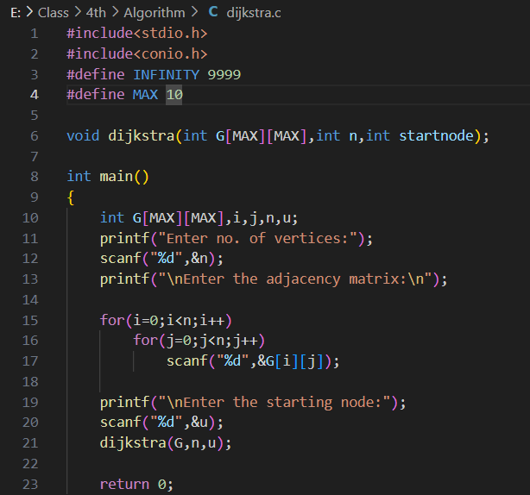
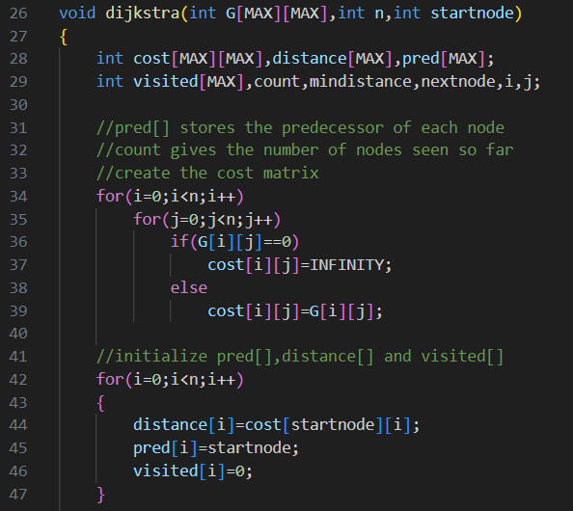
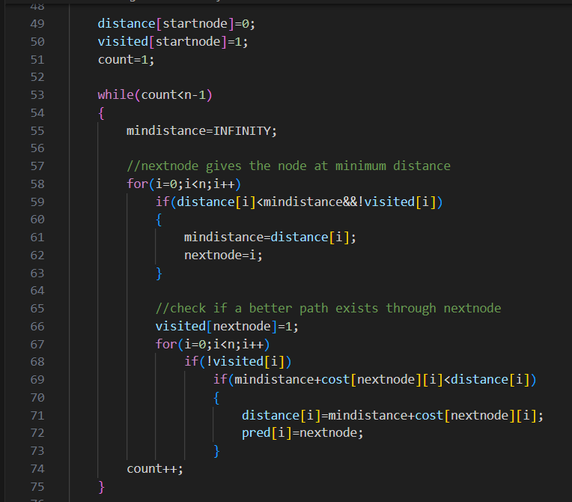
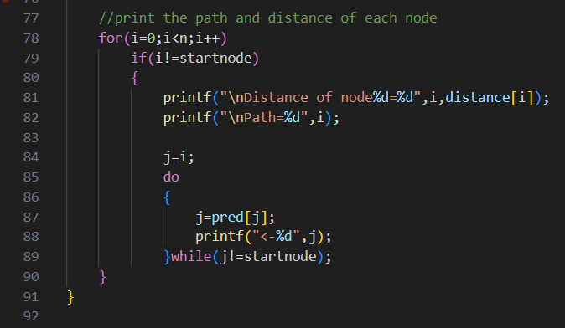

Slide 14
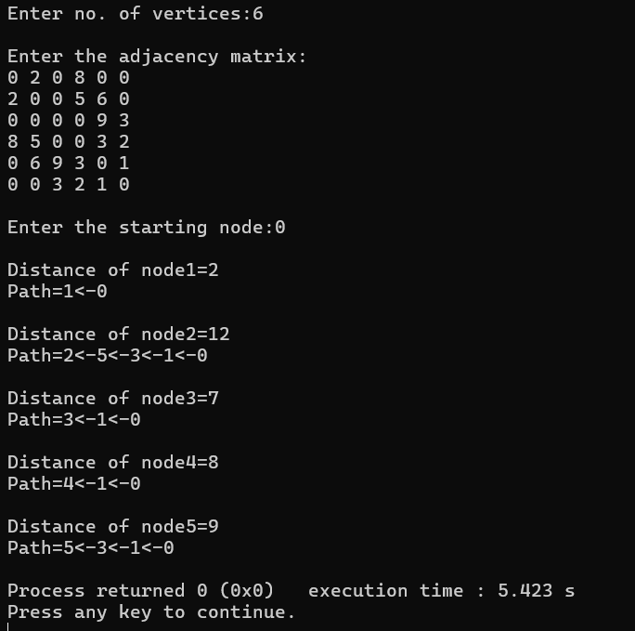
Output :
Adjacency Matrix :
NODE | SHORTEST DISTANCE | PREVIOUSNODE
A | 0
B
C
D
E
F
2
A
12
F
7
B
8
B
9
D

Slide 15
Advantage :
Disadvantage :
Optimality: Dijkstra's algorithm guarantees the shortest path from a single source node to all other nodes in the graph, provided the weights of edges are non-negative.
Efficiency: In the absence of negative edge weights, Dijkstra's algorithm is quite efficient, often outperforming other algorithms for finding single-source shortest paths.
Ease of Implementation: The algorithm is relatively straightforward to implement and understand, making it accessible to a wide range of developers.
Applications: Dijkstra's algorithm finds applications in various fields such as network routing protocols, transportation networks, and computer networking.
Non-negative Weights: Dijkstra's algorithm cannot handle graphs with negative edge weights. This limitation restricts its applicability in some scenarios.
No Negative Cycles: It cannot handle graphs with negative cycles, as it may get stuck in an infinite loop trying to minimize the path length indefinitely.
Memory Usage: Dijkstra's algorithm requires storing information about all nodes in the graph, which can lead to high memory usage, especially for large graphs.
Complexity: While Dijkstra's algorithm is efficient for finding single-source shortest paths, its time complexity can be high for dense graphs or graphs with a large number of vertices and edges.

Slide 16

Conclusion
Any Question ?
In conclusion : Dijkstra’s algorithm stands as a cornerstone in the field of graph theory and computer science, offering an elegant solution to the single-source shortest path problem. Its efficiency and versatility have made it a vital component in the development of various real-world applications, facilitating optimal routing, resource allocation, and decision-making processes. As technology continues to evolve, Dijkstra’s algorithm remains a timeless algorithm, embodying the essence of computational efficiency and problem-solving prowess.

Slide 17
THANK
YOU

